Slide 1
M
Multiple driver research workshop
Location
Date
Presenters
Notes:
Presenter notes:
Each slide has notes to explain the content, timing, and/or activities.
Many slides are hidden, because the decision as to whether or not to present them will depend on whether you choose to show MEDDLE video tutorials or present the content as slides.
Most of the day will spent with small groups working through the simplified decision support tool (DST) to design an experiment. In our experience, this works best with groups of 4, followed by groups of 3, then 5.
Questions? E-mail Christina McGraw (christina.mcgraw@otago.ac.nz)

Slide 2
9:00 – 9:30 Welcome and introduction 9:30 – 10:15 Step 1: Define the research question 10:15 – 10:40 break 10:40 – 11:30 Step 2: Identify the biological traits and responses 11:30 – 12:30 Step 3: Identify the drivers 12:30 – 1:30 Lunch 1:30 – 3:00 Step 4: Experimental design and statistical analysis 3:00 – 3:45 Step 5: Resources 3:45 – 4:15 break 4:15 – 4:50 Introduction to the MEDDLE simulator 4:50 – 5:00 Workshop close
Today
Notes:
The schedule can be adapted, but has worked well for all-day workshops. If this material is intended to be used as part of a class or laboratory, the five steps can be taught over 5 days.
Welcome and introductions. Start the day by having the facilitators and the students introduce themselves, including their research interests and expertise. A facilitator presents slides #1-19.
Step 1: 30 minutes for each group to complete the Step; 15 minutes for groups to report back and have a workshop-wide discussion.
Step 2: as above, but allow 35 minutes for group work and 15 minutes for reporting
Step 3: as above, but allow 45 minutes for group work and 15 minutes for reporting
Step 4: as above, but allow 75 minutes for group work and 15 minutes for reporting
Step 5: as above, but allow 30 minutes for group work and 15 minutes for reporting

Slide 3
Drivers affect the oceans on different scales.
The global increase in human population and atmospheric CO₂ has led to:
Global warming
Ocean acidification
Hypoxia
Increased precipitation
Increased catastrophic events
To address global challenges, we need:
global options (e.g. ↓CO₂ )
global/local data
Notes:
NOTE: The first two slides of this section are just to highlight that we have global impacts and local impacts, just like we have global stressors and local stressors. So, it is important to consider your system and your research question when you decide your experiment. In other words, don’t just study pH and temperature just because that is what the person in the next lab is doing.
Free earth image from: https://pixabay.com/illustrations/globe-world-earth-planet-1339833/

Slide 4
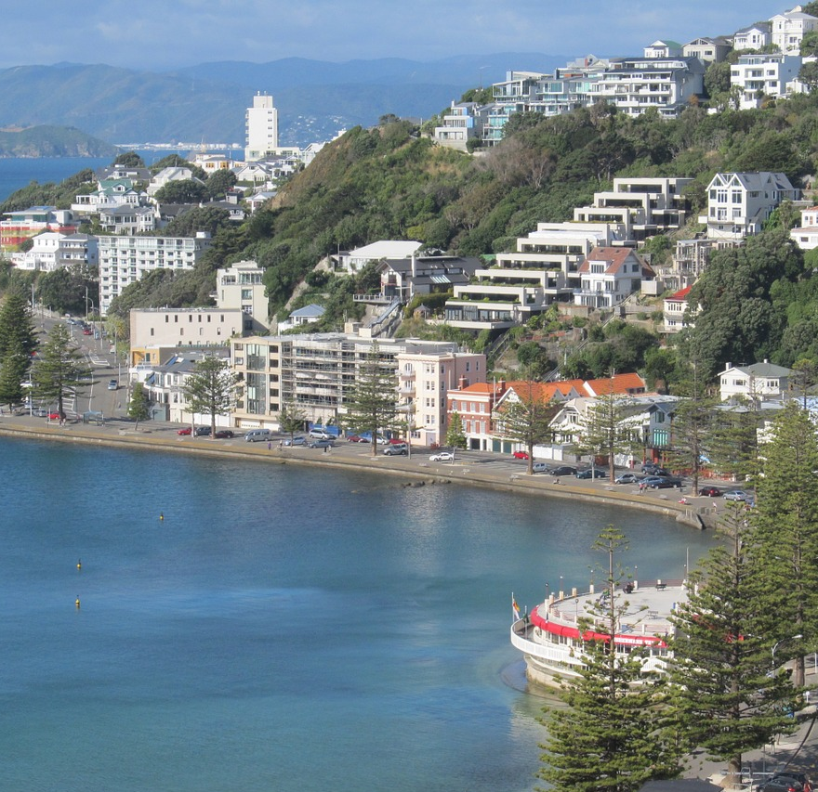
Drivers affect the oceans on different scales.
Local impacts include:
Habitat destruction
Over-exploitation of resources
Local pollution
Introduction of species
etc.
To address local challenges, we need:
local options (management, adaptation, etc)
local data
Notes:
Free of Wellington image from https://pixabay.com/photos/wellington-oriental-bay-new-zealand-1090591/

Slide 5
Driver
Stressor
Stress
Notes:
Note: Take 2-3 minutes and ask groups/people to define these. This works best if you have them talk in their groups first, then have someone from each groups suggest definitions.

Slide 6
A pressure that causes a quantifiable change (positive or negative) an organism, process or community.
Driver
A pressure that causes a quantifiable negative effect on an organism, process or community.
Stressor
A measurable response that is deleterious to an organism, process or community.
Stress

Slide 7
A driver can become a stressor
Intensity
Time exposure
Carry-over effects
Evolution and adaptation
Other drivers
Notes:
Alcohol can become a stressor if you:
Drink too much (Intensity)
Drink too often (time exposure)
Pass on to the next generation through drinking in pregnancy (carry-over effects)
…[Evolution and adaptation]
Combine drinking with other drivers/stressors. For example, under normal circumstances, you may be able to jaywalk across a busy street. However, after a few drinks, your judgement is impaired and suddenly alcohol+crossing because a lot more dangerous than either of them individually.
Free image from: https://pixabay.com/photos/tinto-bordo-wine-glass-alcohol-3608574/

Slide 8
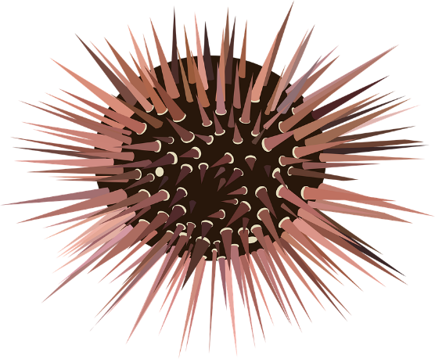
Given your question, do you need to know more about your system?
At 20 ˚C, there is a positive effect of ocean acidification
At 24 ˚C, there was no measurable effect.
At 26 ˚C, there was a negative effect
100
% pluteus larvae
pH 7.9
pH 8.2
0
0
50
0
50
0
50
Time (hour)
Time (hour)
Time (hour)
Figures inspired by Temperature modulates the response of the thermophilous sea urchin Arbacia lixula early life stages to CO₂-driven acidification, https://doi.org/10.1016/j.marenvres.2013.07.008
Notes:
Note 1: Data is inspired by Sam Dupont’s Black Sea Urchin data: https://www.sciencedirect.com/science/article/pii/S0141113613001232#fig3
Note 2: You are trying to get across two points about this multiple driver experiment:
As you increase the temperature, you go from ocean acidification being a positive effect to being a negative effect. In other words, the level of driver 1 (temperature) affects the response to driver 2 (pH).
However, for the most part, both treatments are similar after 50 hours. So, it really highlights that you need to think about when/what frequency you’ll make your measurements. If you only measured after 50 hours, you wouldn’t have picked up this effect.
Image: https://pixabay.com/vectors/urchin-echinoderm-spines-sea-42016/

Slide 9
Given your question, do you need to know more about your system?
Growth
Natural variability range
Notes:
Why this difference in effect? Depending on where in the the response curve we were, giving it a small nudge could have a positive effect or a negative effect. A large effect or a small effect.
Image: https://pixabay.com/vectors/urchin-echinoderm-spines-sea-42016/

Slide 10
Given your question, do you need to know more about your system?
Growth
Natural variability range
Notes:
In this example, we see a
a positive effect if start at the low end of the natural variability range
a negative effect if we start near the peak
or a neutral effect if we happen to choose treatments on either side of the response curve peak.
Image: https://pixabay.com/vectors/urchin-echinoderm-spines-sea-42016/

Slide 11
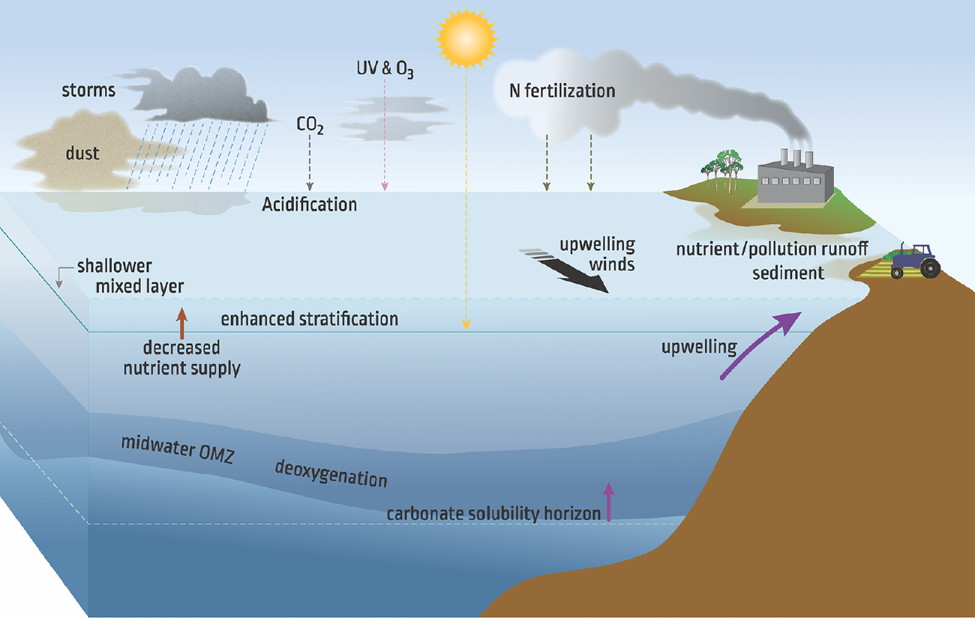
Increasingly complex experiments may decrease our understanding due to too many incompatible approaches and experimental designs.
Boyd et al, Global change biology 24 (6), 2239-2261 (2018)
Notes:
People are usually interested in multiple driver studies because they want to understand what will happen in the future.
However, the drivers can be highly localized and the drivers that are important to you may be very different than the drivers someone else is interested.
All of these different drivers means that there is an infinite number of experimental permutations (and experimental designs) that a researcher may choose to carry out.
This makes more and more challenging to compare experiments (and then provide broad predictions to the public and policymakers) because there are so many incompatible designs and approaches.

Slide 12
The challenge: design an tractable experiment that answers your question
Multiple drivers and interactive effects
Multiple treatment levels and replication
A huge number of potential permutations
+
=
Notes:
The goal of the resources that we will present today are to show you how to carry out efficient designs, so that you can carry out multiple driver experiments under your local conditions, but do so in a way where you can compare the results with other people doing their own local experiments.

Slide 13
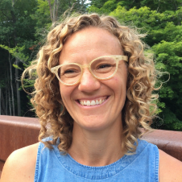
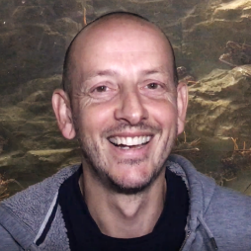
define
identify
decision support tool
design
design
MEDDLE
multiple driver best practice guide
video
tutorials
MEDDLE
experiment
simulator
simulate
refine
analyse
Notes:
The content from today’s workshop comes from the Best Practice Guide to Multiple Drivers Marine Research.
The resource has four key components:
A 48-page best practice guide that gives you a lot of the introductory information about multiple driver experiments.
The Decision Support Tool helps you go from a general question, to something specific you can carry out.
The video tutorials complement the other resources by providing short videos on specialty topics, such as ‘experimental design’, ‘experimental evolution’, ‘data analysis’ and ‘science communication’.
Finally, the MEDDLE simulator allows you to generate multiple driver data (based on real multiple driver experiments!), so you can test out some of your data analysis ideas and make sure you know how to analyse your data before you begin your experiment.

Slide 14
https://meddle-scor149.org/
Notes:
You’ll find these resources on the MEDDLE website

Slide 15
Today: we will use the decision support tools to design a multiple driver experiment
1
2
5
Step 1:
Define the research question
Step 2:
Identify
biological traits
3
4
Step 5: Resources
Step 3:
Identify the drivers
Step 4:
Experimental design
and analysis plan
Notes:
For most people, the Decision Support Tool is the key resource that they will come back to again and again and they design and carry out new experiments.
The decision support tool is designed to help you take a broad research question and narrow it down to something tractable.
It is a series of three iterative loops that will step the you through the decisions needed to arrive an experimental design. It is long.
The full decision support tool (available on the MEDDLE website) consists of the three documents, which total about 20 pages (although only 2-3 questions on each page). But, by the time you reach the end, you’ll have a clear idea of your question, it’s relevance, and the results of similar studies. You’ll have an experimental design and data analysis plan. And, you’ll have a detailed list of your resource requirements.
They are each word-based documents, so you can edit and save the tool as you develop your plan. ***Make sure you distribute the simplified template for this workshop (from the ‘Teaching Resources’ page (https://meddle-scor149.org/teaching-resources/), not the full version***
The full decision support tool consists three loops also offer multiple entry points depending on the your level of expertise on this topic.
For example, a senior researcher may go through it in a couple of hours, while it might take a less experienced researcher a day, and a new post-graduate a week, given the focus on familiarity with relevant literature. It can be filled out as a web form, which is then emailed to you, or you can download it as a word document, for easier editing in the future.
Today’s workshop is structured around a simplified version of these tools, which is much shorter and broken into 5 steps. We’ll used a shared example and then, working in groups, design an experiment in three steps.

Slide 16
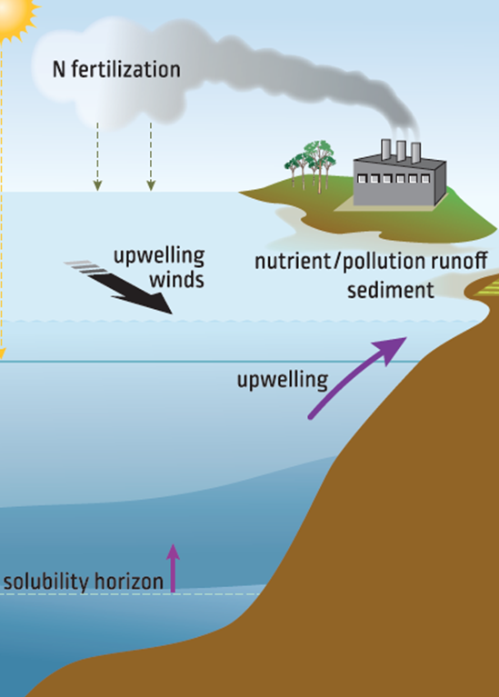
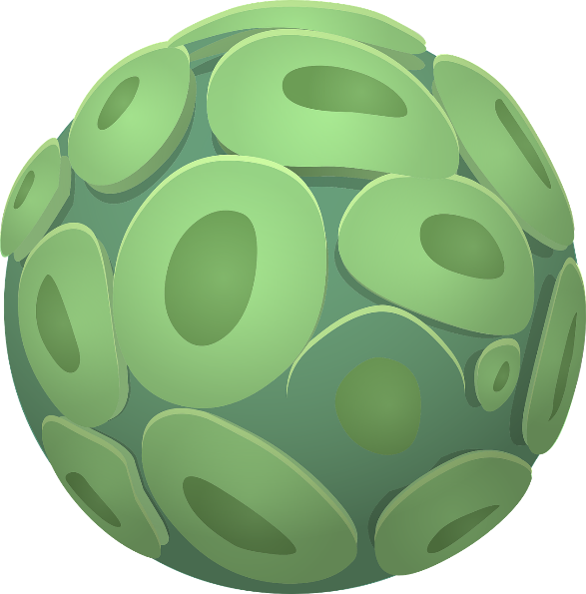
What information do you need for a study?
Understand the possible interactions
Know the drivers (intensity, duration, thresholds, etc)
Prerequisite biological knowledge
Notes:
So, what information will you need to design your experiment?
First, you need to know the drivers in your region, in addition to information about the intensity, fluctuations, etc and what these values may be in the future.
What are the interaction the chosen drivers may have on your study organism or community.
What is the prerequisite biological knowledge? You may – or may not – want to know the response curve for the individual drivers. You probably do want to know about the different life stages and which stages may be more sensitive or robust.
https://pixabay.com/vectors/urchin-echinoderm-spines-sea-42016/

Slide 17
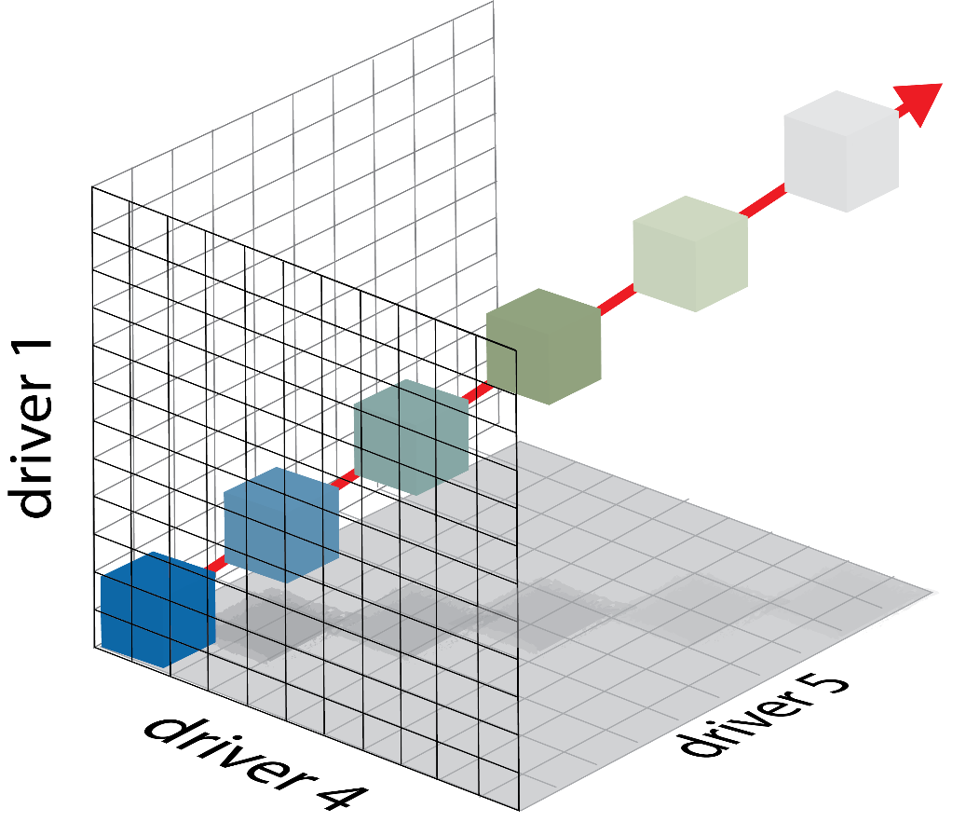
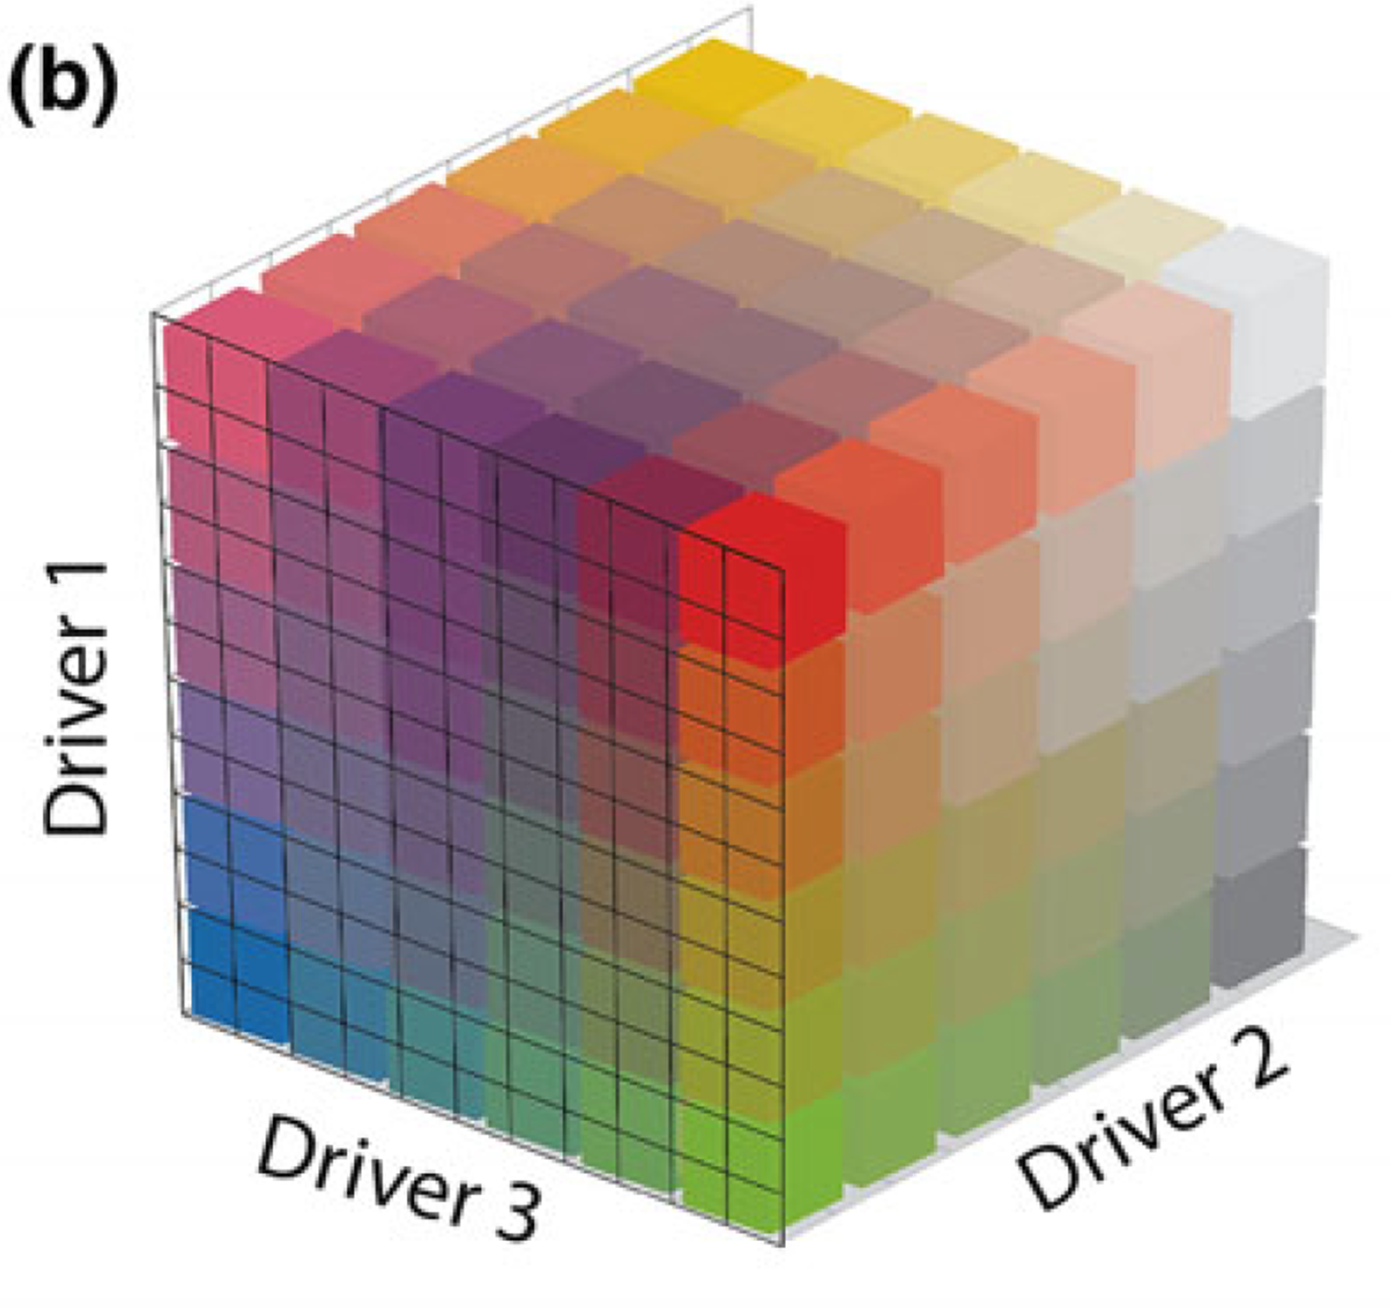
Mechanistic approach:
Use a gradient of
treatment levels to reveal underlying mechanisms.
Scenario approach:
Create a suite of treatments representative of climate change scenarios.
Notes:
Next you will need to decide how to experimentally approach your research question. If you are interested in studying three drivers with six levels for each driver, you may first be tempted by a full factorial approach. This is very intensive (216 experimental units before replication!), but gives you a lot of information about the response to individual drivers and the combined response.
However, if you are only interested in the response to the combined drivers as they project into the future, you may prefer a scenario-based approach where you only look at treatments that represent time points into the future. Here, this requires only 6 experimental units, which gives you a lot more flexibility in terms of replication.

Slide 18
Your question will likely require a research strategy,
not just a single experiment.

Slide 19
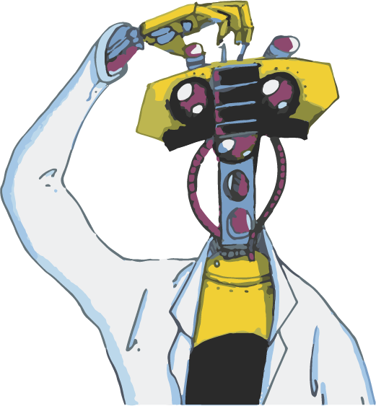
To develop a research strategy, you’ll need:
1
good data on local variability and future scenarios
You may need an understanding of the biological response for each driver (i.e. the mode of action)
2
3
to build models
Mix all these ingredients and test using scenarios in the field and laboratory.
Notes:
To develop this research strategy, you’ll need everything we’ve mentioned before. And, when you carry out the experiments, you will also be able to build models, which will inform future experiments.

Slide 20
M
Step 1:
Define the
research question
MEDDLE: A guide to running best practice experiments in ocean research

Slide 21
There are over 3600 mollusc species New Zealand waters, which play important roles in maintaining a healthy ecosystem and have significant cultural, recreational and commercial value.
Goal for today: Design an experiment (or research strategy) to help us understand the impact of the changing oceans on the green-lipped mussel.
Notes:
NOTE: you will want to update slide to highlight a species relevant to your location.
If you continue to use green-lipped mussels, here are some fun facts from Ocean acidification in New Zealand waters: trends and impacts (CS Law et al, New Zealand Journal of Marine and Freshwater Research, 52:2, 155-195, DOI: 10.1080/00288330.2017.1374983) :
Export value of NZ’s molluscs: 339M NZD in 2016
Green-lipped mussels support “New Zealand’s largest aquaculture export industry, exceeding USD$190 m p.a. in value.”

Slide 22
In your group, define your research question using the Decision Support Tool (Step 1).
Task

Slide 23
One person from each group should tell us
(2-minute maximum):
The objective of your study.
The environmental drivers may affect your study.
The necessary biological knowledge.
Discuss
Notes:
This is a chance for each group to explain their ideas and get feedback from everyone else.
Most groups take 4 minutes: 2 minutes to talk; 2 minutes for questions/comments.

Slide 24
Regroup at 10:40
Break

Slide 25
M
Step 2:
Identify the biological traits and responses
MEDDLE: A guide to running best practice experiments in ocean research

Slide 26
In your group, identify biological traits and responses using the Decision Support Tool (Step 2).
Task

Slide 27
One person from each group should tell us
(2-minute maximum):
The biological responses/traits will you measure.
The biological variation you expect in the response/traits.
The expected spatial/temporal dynamics and your plan to. accommodate these dynamics.
Discuss
Notes:
This is a chance for each group to explain their ideas and get feedback from everyone else.
Most groups take 4 minutes: 2 minutes to talk; 2 minutes for questions/comments.

Slide 28
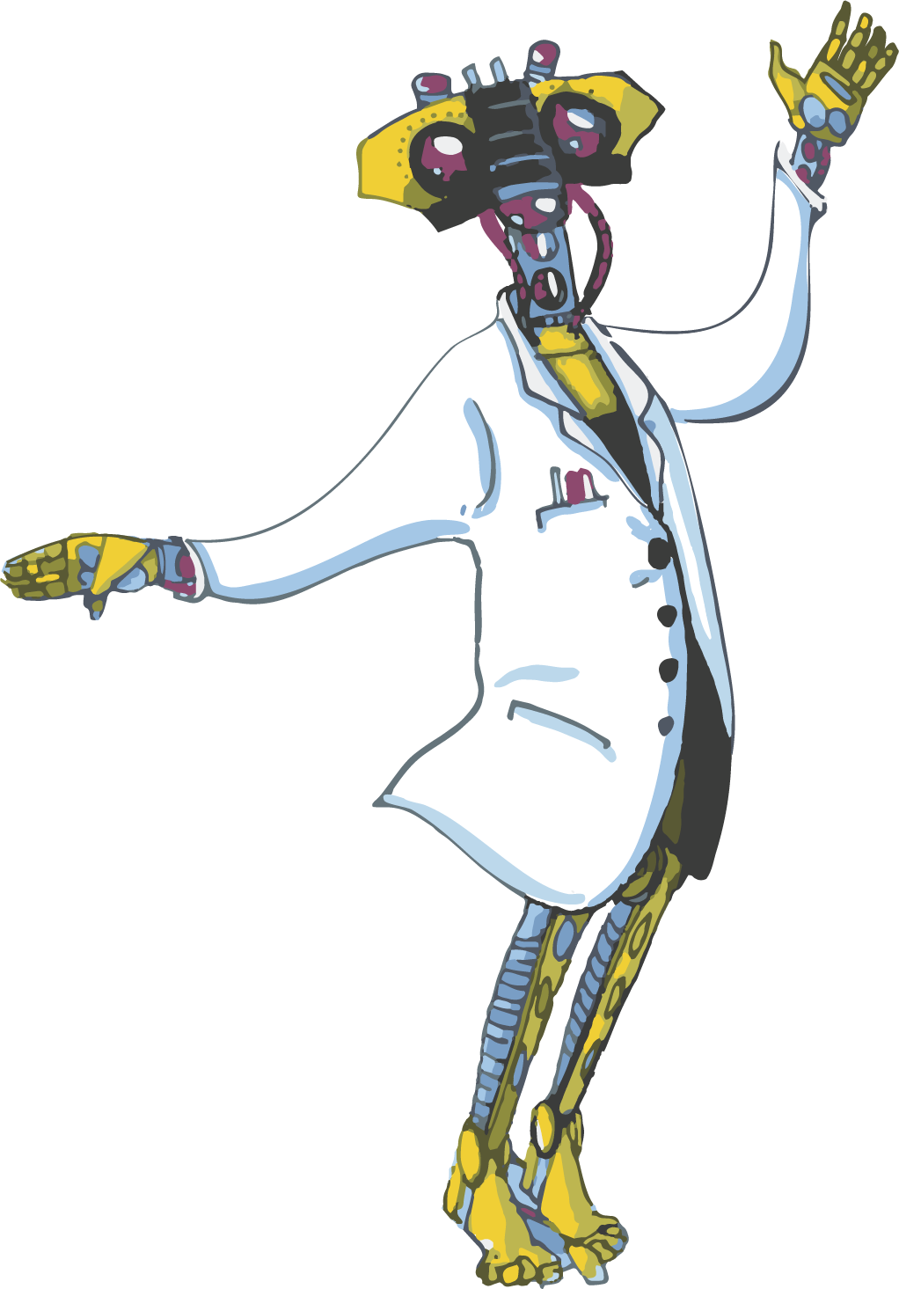
M
Step 3: Developing a driver inventory
MEDDLE: A guide to running best practice experiments in ocean research

Slide 29
Notes:
Watch the video (5 minutes)
https://www.youtube.com/watch?v=fCBciRJidIg

Slide 30
What are the key points of the video?
Notes:
10 minute white board discussion.
If the discussion needs redirecting, have the group start a list of stressors in a nearby location.

Slide 31
In your group, identify the drivers using the Decision Support Tool (Step 3).
Task

Slide 32
One person from each group should tell us
(2-minute maximum):
The drivers you will include in your study.
How you will measure each driver.
Whether your drivers are constant or variable and how you will address variability.
Whether you expect interactions amongst your drivers.
Discuss
Notes:
This is a chance for each group to explain their ideas and get feedback from everyone else.
Most groups took 4 minutes: 2 minutes to talk; 2 minutes for questions/comments.

Slide 33
Regroup at 1:30
Lunch

Slide 34
M
Step 4:
Experimental design and statistical analysis
MEDDLE: A guide to running best practice experiments in ocean research

Slide 35
Our goal:
Design an experiment as simple
as it can be. But no simpler.

Slide 36
Notes:
Watch this video (16 minutes)
https://www.youtube.com/watch?v=AthzYRVIFyw

Slide 37
What are the key points of the video?
Notes:
5-10 minute white board discussion.

Slide 38
A good data analysis plan will help you
Answer your research questions
Maximise information and minimise effort
Know – and be able to defend – your assumptions
Reduce cost and wisely allocated limited resources
Get published
Avoid catastrophe
Notes:
It is essential to develop a data analysis plan as part of your experimental design.
https://www.youtube.com/watch?v=hH_3NZFW7EI

Slide 39
Notes:
If you are teaching this as part of a 1-day workshop, three videos is too many (especially since this would come right after Experimental Design). Instead, it is better to summarise some of the key points of the video using the slides below. If you choose to do this, watch the video first:
https://www.youtube.com/watch?v=hH_3NZFW7EI

Slide 40
What are the key points of the video?
Notes:
5-10 minute white board discussion.

Slide 41
Notes:
See the video for the discussion about these slides, so you can ensure it is at the correct level for your students.
https://www.youtube.com/watch?v=hH_3NZFW7EI

Slide 42
Instead of asking
“Is there a difference?”
a more interesting question is
“What is the difference”?

Slide 43
Interesting
Difference in means
0
Ignorable
Interesting
Notes:
For example, we may be interested in measuring the difference between two treatments. The difference may be positive or negative or large or small. However, it can be difficult to measure small differences.

Slide 44
Interesting
Difference in means
0
Ignorable
Interesting
Notes:
If you consider the arrows confidence intervals, you can discuss how you would interpret these results.

Slide 45
Growth rate
Now
Future
Notes:
In the simplest scenario, we may have only two treatments and we can quantify their difference with a mean and 95% confidence interval.

Slide 46
Growth rate
2020
2060
2100
2200
Pre-industrial
Notes:
However, we may want the additional information that comes with more treatment levels.
Let’s consider a future ocean experiment, where we expect the data to look like this.

Slide 47
Unless you are a physical scientist,
you are unlikely to see data like this
Growth rate
2020
2060
2100
2200
Pre-industrial
Notes:
However, we are unlikely to see data that is so clear!

Slide 48
Growth rate
2020
2060
2100
2200
Pre-industrial
Notes:
Instead, using the same level of noise we had in our two-treatment scenario, our data may look like this

Slide 49
Growth rate
2020
2060
2100
2200
Pre-industrial
Notes:
Or this

Slide 50
Growth rate
2020
2060
2100
2200
Pre-industrial
Notes:
Or this

Slide 51
Growth rate
2020
2060
2100
2200
Pre-industrial
Notes:
Or this

Slide 52
Analysing your 5-scenario data
Option 1: Analyse each treatment individually
Growth rate
Option 2: Fit the response curve to describe a gradient,
e.g. linear, quadratic or GAM
2020
2060
2100
2200
Pre-industrial
Notes:
You have a lot more analysis options here. However, it is important to consider how you will analyse the data before you begin.

Slide 53
Tips and tricks
Know how you will analyse your data before you begin.
Perform a power calculation.
Simulate data and analyse your simulated data.
Use the results from your simulation to refine your question and redesign your experiment.
Don’t hesitate to carry out a small pilot study.
Include extra replicates.
Consult with a statistician before you start the experiment.

Slide 54
You have finite resources!
You must keep your experiment to
< 1000 experimental unit days
If you require 20 experimental units, you can run your experiment for 50 days.
If you require 100 experimental units, you can run your experiment for 100 days.
Notes:
As you develop your experiment, you will be limited by money, tanks and time.
NOTE: Introduce a new term: experimental unit days. This includes replicates. However, you may also need to introduce the term “experimental unit”!
NOTE: depending on the broad goal you defined earlier (i.e. green-lipped mussels), you will need to change the constraints. For example, it may be more relevant to say: “you have 20 days and 24 culture tanks”.

Slide 55
In your group, develop a experimental design and analysis plan using the Decision Support Tool (Step 4).
Task
Notes:
This is the longest task. Give 90 minutes, include the 15 minute reporting period.

Slide 56
One person from each group should tell us (2 min):
The number of treatment levels per driver and the number of replicates per treatment.
The experimental sampling unit.
The most relevant control.
The statistical analysis or modelling approach will you use.
Discuss
Notes:
This is a chance for each group to explain their ideas and get feedback from everyone else.
Most groups took 4 minutes: 2 minutes to talk; 2 minutes for questions/comments.

Slide 57
M
Step 5:
Resources
MEDDLE: A guide to running best practice experiments in ocean research

Slide 58
In your group, identify the necessary resources using the Decision Support Tool (Step 5).
Task

Slide 59
One person from each group should tell us
(2-minute maximum):
How long will the study will take and how much it will cost.
The most significant constraints and how they can be overcome.
Discuss
Notes:
This is a chance for each group to explain their ideas and get feedback from everyone else.
Most groups took 4 minutes: 2 minutes to talk; 2 minutes for questions/comments.

Slide 60
The decision support tools can help you design a tractable research strategy that will answer your question.
1
2
5
Step 1:
Define the research question
Step 2:
Identify
biological traits
3
4
Step 5: Resources
Step 3:
Identify the drivers
Step 4:
Experimental design
and analysis plan
Notes:
You have seen how a decision support tool can help you design and carry out a tractable research strategy. However, remember that we used the simplified version of the decision support tool today. The full version, which is three separate documents, can help you work out additional details and is available on the MEDDLE website.

Slide 61
Regroup at 4:15
Break

Slide 62
M
The MEDDLE Simulator
MEDDLE: A guide to running best practice experiments in ocean research

Slide 63
https://meddle-scor149.org/
Notes:
Go to the website and do a short demo. However, don’t show the surface at first! Do a 3x3 matrix, then ask people what they think the response looks like. Then add a few more points and ask again. Then, put the response surface in.
Go to the actual website (easiest if you have it already open on a webpage and ready to go)
Point out the resources in the middle bar, including the pdf handbook
Click on MEDDLE Simulator
Skip straight to ‘Simulate’
Create a new data set (+ sign)
Select a 3-D: R,D1, D2. Select ‘okay’
Add two more treatments to Driver 1 and Driver 2, so you have three of each.
Select ‘generate’
Twirl it around a bit. Then go back and add more treatments to Driver 1 and Driver 2. Re-generate.
Eventually, add the response surface.

Slide 64
www.meddle-scor149.org
Thank you!
Notes:
These resources would not have been possible without the support of all of our sponsors and the work of SCOR Working Group 149 members.

